Slide 1
From Adoption to Creation: A Faculty Guide to Open Educational Resources
Shepherd University Faculty Professional Development Day 2026
Joshua Beck
Amanda Mandzik
Zahra Pourabedin
Robert Szarka
James Dovel

Slide 2
OER: What, Why, How?

Slide 3
What is OER?
“Open Educational Resources (OER) are teaching, learning, and research materials intentionally created and licensed to be free for the end user to own, share, and in most cases, modify.” – Wikipedia (CC-BY-SA 4.0 International)
Typically made available under one of the licenses from Creative Commons.

Slide 4
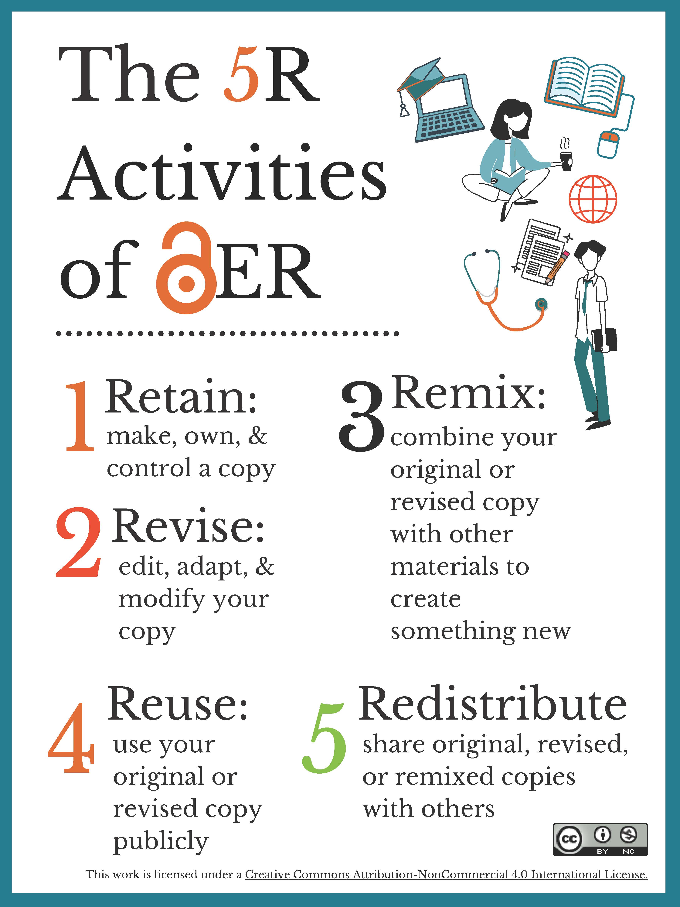
The 5 R’s of OER

Slide 5
Why OER?
Benefits to students: costs savings; access to class materials before, during, and after the course; opportunities to contribute (“open pedagogy”).
Benefits to instructors: freedom to adapt materials to instructional needs and improve quality/accessibility; professional development.

Slide 6
OER in West Virginia
In 2019, WV passed legislation encouraging OER use
Since 2021, Open Learning WV efforts have produced $10 million in textbook savings
Initially offered $1,000 grants ($2,500 for STEM subjects) for faculty to adopt OER in their classes
For 2025–2026, awarded ten $25,000 OER Challenge Grants
More grant opportunities expected in 2026–2027…

Slide 7
Get Involved!
There are endless ways to contribute! [Here’s a handout with a very long list.]
E.g.:
Adopt OER
Review and Curate Collections of OER
Adapt, Improve, and Remediate Existing OER
Create New OER Works (possibly with your students!)
Evangelism, Policy Work, and Grant Activity

Slide 8
Learning More About OER
Join OpenLearningWV-L (contact Beez Schell)
Attend WV HEPC’s OER Convening (usually in April)
Read The OER Starter Kit
Read A Guide to Making Open Textbooks with Students
Watch Rob’s screencast OER: What, Why, and How
More resources coming from Rob soon on Brightspace…

Slide 9
Finding OER to Adopt and Adapt
MERLOT
OER Commons
Pressbooks
MIT OpenCourseWare
OpenStax
SkillsCommons
Shepherd’s Brightspace Learning Object Repository

Slide 10
Contact Rob
Reach out for help on anything OER related, from understanding the basics to packaging your textbook for redistribution.
Email: rszarka@shepherd.edu
Web: szarka.org
Blog: OERforge.com

Slide 11
An OER First-Timer:
Challenges & Rewards
Mandy Mandzik

Slide 12
Past Experience
Got started teaching Introductory Macroeconomics & Statistics using Pearson & McGraw-Hill platforms
Transitioned out of using the platform for Macro (on my own)
Just started OER for Stat this spring (with encouragement & help ☺)
Notes:
Speaker notes here.

Slide 13
Challenges and Solutions
Challenges
Solutions
The need to create technical homework and test problem sets—fast!
The need to fill gaps for online students
Ensuring content is Title II compliant
Used test bank and instructor resources included with OER text
Created customized content (PowerPoints, videos, & PDFs) emphasizing important concepts
University-wide effort with resources & help available
Notes:
Speaker notes here.

Slide 14
This Semester’s Experience:
Contending with Multiple Variables
OER and In-class exams for the first time!
Positive Feedback:
“The material that this professor created to assist in the learning of each chapter was extremely helpful and much easier to follow and understand than the ‘textbook’ material.”
Notes:
Speaker notes here.

Slide 15
Rewards
More customized/individualized experience for students
Taking the “classroom” back—gives instructor control again
Makes student evaluations more meaningful
Notes:
Speaker notes here.

Slide 16
Another OER First-Timer:
Challenges & Rewards
Zahra Pourabedin

Slide 17
My Lumen Circles Experience
Teaching with OER & OER-Enabled Pedagogy
9-week faculty fellowship
2–3 hours per week
Small faculty Circle with a facilitator
Learning, application, reflection, and peer feedback

Slide 18
What I Learned About OER: Beyond “Free”
Keep your 5Rs:
Retain — keep a copy
Reuse — use it in different ways
Revise — modify or adapt it
Remix — combine it with other resources
Redistribute — share it with others
OER is not simply free content. Open licensing allows us to adapt, improve, and share resources.

Slide 19
My Takeaway: OER-Enabled Pedagogy
Traditional approach
Teacher provides resource → Student reads → Student completes assignment
OER-enabled approach
Student finds/adapts/creates → Improves → Shares → Others benefit
Students move from consumers of knowledge to creators and contributors.

Slide 20
What Made the Lumen Experience Different
Supportive & Varied
↓
Reflection & Goal Setting
↓
Belonging
↓
Organized & Challenging
Lumen connected OER with evidence-based instructional practices, rather than treating OER only as a textbook replacement.

Slide 21
Why I Tried OER?
• Reduce textbook costs for students
• Increase accessibility from day one
• Allow flexibility in teaching materials
• Explore more engaging and updated content

Slide 22
How I Can Apply This in Marketing
Traditional Assignment
Read about market segmentation
↓
Answer questions
↓
Submit to instructor
OER-Enabled Assignment
Explore an open resource
↓
Find examples from local businesses
↓
Adapt the resource with new examples
↓
Create an infographic/resource
↓
Peer review & improve
↓
Share

Slide 23
What I Took Away from Lumen
1. OER is more than affordability.
It creates opportunities for adaptation and sharing.
2. OER can change the role of students.
Students can become creators rather than only consumers.
3. Start with pedagogy, not just resources.
The question is not only “What OER can I use?” but also “What can students do with it?”
When we prepare our teaching materials, do we usually give students materials to consume, or do we give them opportunities to create, adapt, and share?

Slide 24
Course Context
Course: Principles of Marketing
Student level: Undergraduate
Delivery format: In-person / online
OER materials used:
OpenStax
Videos
Articles

Slide 25
What Worked Well
Students appreciated free access
No delays in obtaining materials
Easier to share updated examples
Greater flexibility in assignments and discussions

Slide 26
Challenges I Faced
Time required to locate quality materials
Organizing content
Adapting materials to course objectives
Ensuring consistency in depth and quality
Finding engaging interactive materials

Slide 27
What I learned
OER requires planning and curation
Flexibility is a major advantage
Student engagement increases with diverse resources
Continuous improvement is important

Slide 28
Plans for Next Semester
Refine course organization
Add more interactive activities
Include additional case studies
Develop clearer weekly resource guides
Gather more structured student feedback
Explore collaborative OER creation opportunities

Slide 29
Recommendations for Faculty
Start small
Align OER with learning outcomes
Use multiple resource types
Collect student feedback regularly
Collaborate with colleagues and librarians

Slide 30
Conclusion
First experience with OER was positive
Benefits outweighed challenges
OER can improve affordability and accessibility
Excited to continue improving the course
Thank you!

Slide 31
Open Pedagogy in Practice
Josh Beck

Slide 32
Agenda
OER progression: first starting point to current work
Share some examples of Open Pedagogy success
Highlight student authored textbooks using discussion boards
Skill building for students with OER involvement
Key Takeaways

Slide 33
The OER Journey Begins
OER - Reminisced back in time
Share your potential goals far and wide
Obtained resources from colleagues here and elsewhere

Slide 34

Open Pedagogy in Practice 1
In addition to the book, Instructor Resources are included:
PowerPoint slides
Test bank
The book was very well done

Slide 35

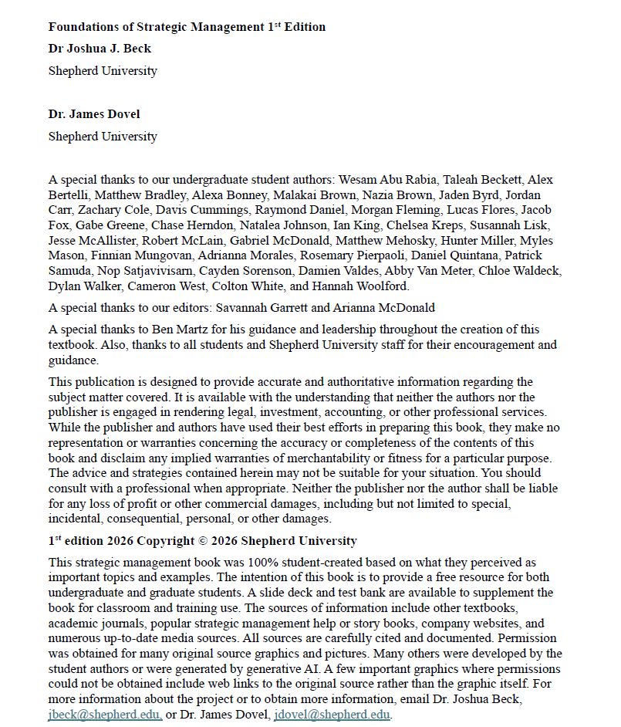
Open Pedagogy in Practice 2
Although the textbook was excellent, as professors we often like to reorganize content and add our own perspective.
That lead me to generate a student authored textbook.
This is almost complete and great way to get students a line on their resume for student authorship.

Slide 36

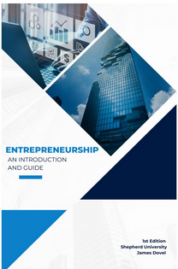

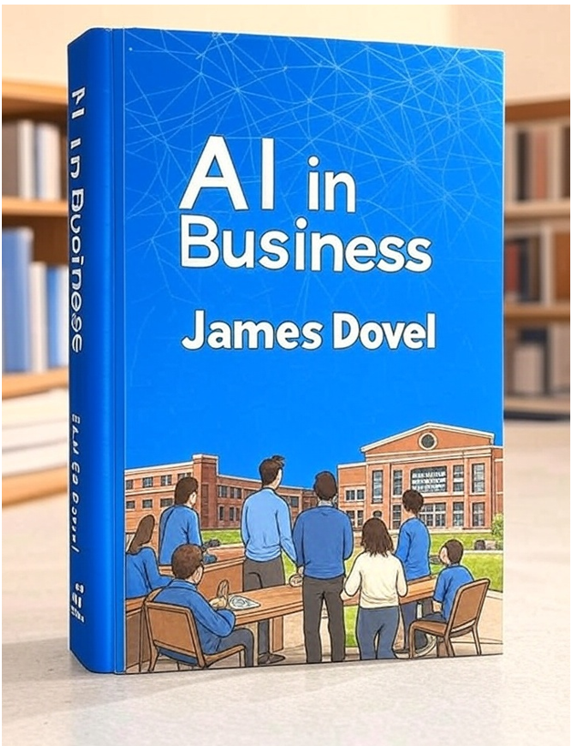
From User To Creator
Got the idea from my colleague Dr. Dovel
He has a discussion board approach to building textbooks

Slide 37
Build A Textbook Forum Directions
The Process
Each Student Delivers:
Students choose a weekly topic in Brightspace
Use Discussion Forum Tool
Resources from purchased books, personal library, assigned list
Two-week cycle per assignment
Title & Subject
Main Post
Discussion Question
Multiple Choice Question
PowerPoint Presentation
Lecture Notes
References

Slide 38
Build A Textbook Chapter: Editing and Peer Review
Student posts are combined into Chapters, Slide Decks, and Test Banks
Students edit a chapter that is not theirs:
  genuine peer review
Turnitin tool used to verify originality and flag plagiarism
Student feedback combined with instructor feedback iteratively
Books are required to be returned after editing process
Don’t stress about perfection at first

Slide 39
Put On Your Own Twist
Dr. Dovel’s technique gave me a foundation
Now I have my own way that I have been tweaking and adding to it each semester
Great to get started and then learn from the experience to decide how you want to do it

Slide 40
Win-Win
What Students Get:
Publication credit
Work experience
Resume builder
Real skill development
Copy of the book
MBA Capstone Skills Built:
Project management
Time management
Risk management
Graphic Design
AI
Teamwork
Communication

Slide 41
A Natural Life of Its Own
We have a student building PowerPoint presentations for the project
We will have English students edit it one more time for us
We had students help with activities and a test bank
Lead to Grant Opportunity

Slide 42
Key Takeaways
Feels Scary
Tell the people around you
Start Small
Take incremental wins
Feels rewarding to give back to the students

Slide 43
Making it Count
Jim Dovel

Slide 44
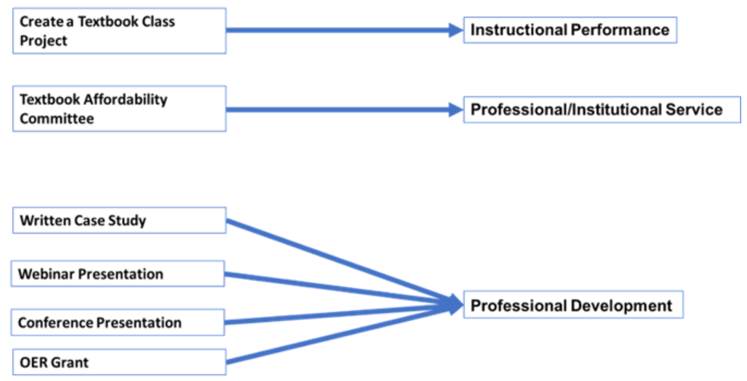
OER in Tenure and Promotion
Dovel, J. (2024). Significant value added to tenure application by developing and promoting OER materials. In A. McKinney (Ed.), Valuing OER in the tenure, promotion, and reappointment process. CUNY Pressbooks. https://pressbooks.cuny.edu/tenureandpromotioncasestudies/chapter/significant-value-added/

Slide 45
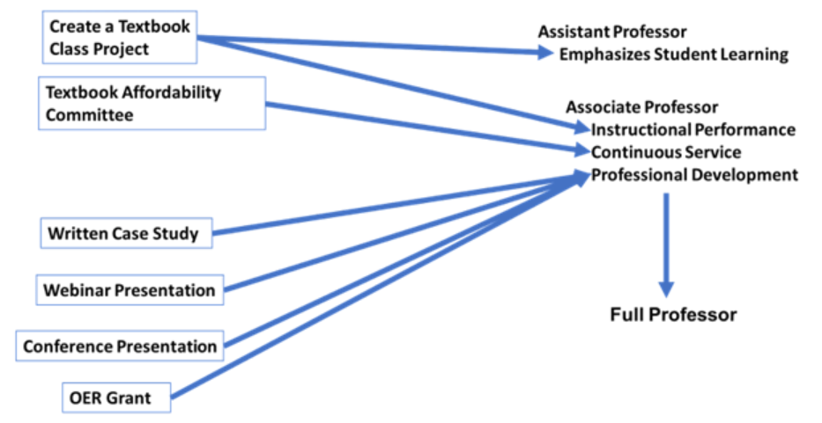
OER Application to Faculty Promotion
Dovel, J. (2024). Significant value added to tenure application by developing and promoting OER materials. In A. McKinney (Ed.), Valuing OER in the tenure, promotion, and reappointment process. CUNY Pressbooks. https://pressbooks.cuny.edu/tenureandpromotioncasestudies/chapter/significant-value-added/

Slide 46
What Do the Students Get out of This?
Research, Writing, Presentation, Teamwork Skills
Project Management
Authorship, resume item
Real world experience
More engaging course material
Up to date material

Slide 47
What Can You Get out of This?
Course cartridge available (Josh, Rob, Yildiz, Rich)
Scholarship
Improved teaching / open pedagogy / RSI / AI resistant assignments
Funded grants
Funded authorship
Funded conferences

Slide 48
How do we know that the OER information is right?

Slide 49
Thanks / Questions?

Slide 50
Credits
Copyright 2026 Robert Szarka, Joshua Beck, Zahra Pourabedin, Jim Dovel, and Amanda Mandzik. Licensed under Creative Commons Attribution 4.0 International. To view a copy of this license, visit https://creativecommons.org/licenses/by/4.0/.

